Slide 1
One Bit Flips, One Cloud Flops: Cross-VM Row Hammer Attacks and Privilege Escalation
Y. Xiao, X. Zhang, Y. Zhang, R. Teodorescu
Row Hammer
Yuan Xiao, Xiaokuan Zhang, Yinqian Zhang, Radu Teodorescu
The Ohio State University

Slide 2
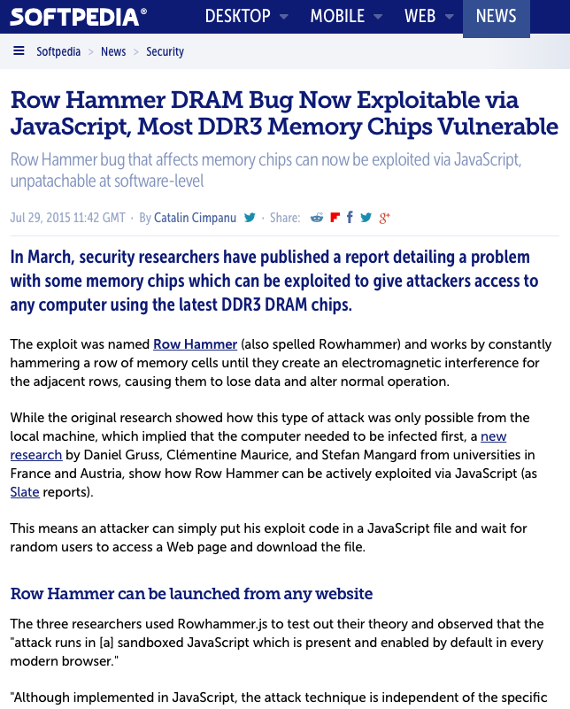

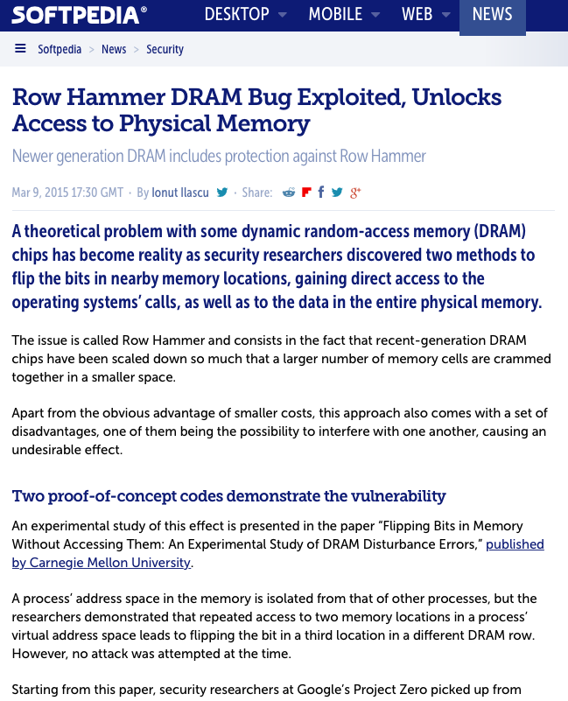

Row Hammer Vulnerabilities and Exploits
Y. Xiao, X. Zhang, Y. Zhang, R. Teodorescu
Once thought safe, DDR4 memory shown to be vulnerable to “Rowhammer”, March 17 2016
Row Hammer DRAM Bug Now Exploitable via JavaScript, Most DDR3 Memory Chips Vulnerable, July 29 2015
Row Hammer DRAM Bug Exploited, Unlocks Access to Physical Memory, March 9 2015
Flipping DRAM bits - maliciously, December 29, 2014

Slide 3
DRAM Architecture
Y. Xiao, X. Zhang, Y. Zhang, R. Teodorescu
Rank 1 (back)
Channel
Rank 0 (front)
DIMM
Data bus
64-bit

Slide 4
Row Buffer and Row Activation
Y. Xiao, X. Zhang, Y. Zhang, R. Teodorescu
Columns
A memory block (one byte)
Activation (Charging)
Bank
Rows
Read/Write
I/O Bus
Row Buffer

Slide 5
Disturbance Errors (1)
Y. Xiao, X. Zhang, Y. Zhang, R. Teodorescu
[ISCA‘14] Kim et al.
0 | 1 | 1 | 0 | 1 | 1 | 0 | 0
0 | 0 | 0 | 1 | 1 | 1 | 0 | 1
rapid row activation
one bit,
not one byte.
Row Buffer

Slide 6
Disturbance Errors (2)
Y. Xiao, X. Zhang, Y. Zhang, R. Teodorescu
[ISCA‘14] Kim et al.
0 | 1 | 1 | 0 | 1 | 1 | 0 | 0
0 | 0 | 0 | 1 | 1 | 1 | 0 | 1
rapid row activation
0 | 0 | 0 | 1 | 0 | 1 | 0 | 1
bit flips in neighboring rows
Row Buffer

Slide 7
Double-sided Row Hammer Attack
Y. Xiao, X. Zhang, Y. Zhang, R. Teodorescu
(Upper)
Victim Row
0 | 1 | 1 | 0 | 1 | 1 | 0 | 0
0 | 0 | 0 | 1 | 0 | 1 | 0 | 1
1 | 1 | 0 | 0 | 0 | 1 | 1 | 0
0 | 0 | 1 | 0 | 1 | 1 | 0 | 0
(Middle)
High-risk Victim Row
Hammering Rows
0 | 0 | 0 | 1 | 0 | 1 | 1 | 1
1 | 1 | 1 | 0 | 0 | 1 | 1 | 0
(Lower)
Victim Row
Row Buffer

Slide 8
Related Work
Y. Xiao, X. Zhang, Y. Zhang, R. Teodorescu
Kim, et al. [ISCA ‘14]
Seaborn (Google), 2015
R3dF09 (Tencent), 2015
Bosman, et al. [SOSP ‘16]
Gruss, et al. [DIMVA ’16]
Single-sided vs. double-sided row hammer
Exploitation scenarios

Slide 9
Y. Xiao, X. Zhang, Y. Zhang, R. Teodorescu
How to conduct double-sided row hammer attacks?
How to exploit row hammer vulnerabilities in cross-VM settings?

Slide 10
Outline
Y. Xiao, X. Zhang, Y. Zhang, R. Teodorescu
Reverse-engineer DRAM Mapping
Cross-VM Row Hammer Exploitation
Case studies

Slide 11
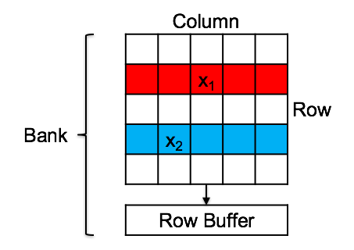
Difficulties in Double-sided Row Hammer
Y. Xiao, X. Zhang, Y. Zhang, R. Teodorescu
Physical Address
x₁
Which bank?
Which row?
Same bank?
Neighboring rows?
Physical Address
x₂
Which bank?
Which row?

Slide 12
A Basic Timing Channel Primitive
Y. Xiao, X. Zhang, Y. Zhang, R. Teodorescu
Bank b₁
Bank b₂
Column
Column
 |  | x₁
 | x₂
T₁=2*T_{activate}
+2*n*T_{read}
 |  | x₁
T_{activate}
Row
Row
 | x₂
Row Buffer
Row Buffer
Row Buffer
read x₁
Row Buffer
read x₂
T_{read}

Slide 13
Basic timing channel primitive
Y. Xiao, X. Zhang, Y. Zhang, R. Teodorescu
Column
 |  | x₁
 | x₂
T₁=2*T_{activate}
+2*n*T_{read}
 |  | x₁
T₂-T₁=2*(n-1)*T_{activate}
T₂ > T₁
Row
Bank
 | x₂
T₂=2*n*T_{activate}
+2*n*T_{read}
Row Buffer
Row Buffer
Row Buffer
read x₂
read x₁

Slide 14
Basic timing channel primitive
Y. Xiao, X. Zhang, Y. Zhang, R. Teodorescu
same bank
different row
High latency
What if the two physical addresses differ only in specific bit positions?

Slide 15
Row Bit Detection
Y. Xiao, X. Zhang, Y. Zhang, R. Teodorescu
 | 21 | 20 | 19 | 18 | 17
… | 0 | 1 | 1 | 0 | 0 | …
Read
Physical Address x₁
 | 21 | 20 | 19 | 18 | 17
… | 0 | 0 | 1 | 0 | 0 | …
Read
High latency?
Physical Address x₂
… | 21 | 20 | 19 | 18 | 17 | …
Bit 20 decides the row, but not the bank.
Bit Index of a Physical Address

Slide 16
Column Bit Detection
Y. Xiao, X. Zhang, Y. Zhang, R. Teodorescu
 | 21 | 20 | … | 4 | 3
Bit 4 does not decide
the bank.
(but decides column)
… | 0 | 1 | … | 1 | 0 | …
Read
Physical Address y₁
 | 21 | 20 | … | 4 | 3
… | 0 | 0 | … | 0 | 0 | …
Read
High latency?
Physical Address y₂
… | 21 | 20 | … | 4 | 3 | …
Bit 20 decides the row, but not the bank.
Bit Index of a Physical Address

Slide 17
Row/Column Bit Summary
Y. Xiao, X. Zhang, Y. Zhang, R. Teodorescu
row bits
other bits
column bits
Bit Index of a Physical Address
White bits: always show low latency in previous two kinds of tests.

Slide 18
XOR Scheme Detection (1)
Y. Xiao, X. Zhang, Y. Zhang, R. Teodorescu
 | 19 | 18 | 17 | 16 | 15
Row Bit
… | 0 | 1 | 1 | 1 | 0 | …
… | 19 | 18 | 17 | 16 | 15 | …
Physical Address z₁
 | 19 | 18 | 17 | 16 | 15
… | 0 | 0 | 1 | 0 | 0 | …
Bank Bit
+
Physical Address z₂

Slide 19
XOR Scheme Detection (2)
Y. Xiao, X. Zhang, Y. Zhang, R. Teodorescu
 | 19 | 18 | 17 | 16 | 15
… | 0 | 1 | 1 | 1 | 0 | …
Read
Physical Address z₁
 | 19 | 18 | 17 | 16 | 15
Bit 18 (higher bit) should be row bit
… | 0 | 0 | 1 | 0 | 0 | …
Read
Physical Address z₂
different row
same bank
Either 18 or 16 decides the row
High latency?

Slide 20
XOR Scheme Detection (3)
Y. Xiao, X. Zhang, Y. Zhang, R. Teodorescu
test | 18 | 16 | 18 ⊕ 16 | latency | bank | row
1 | 1 0 | 1 1 | 0 1 | low | different | different
2 | 1 0 | 1 0 | 0 0 | high | same | different
3 | 1 0 | 0 1 | 1 1 | high | same | different

Slide 21
XOR Scheme Detection (4)
Y. Xiao, X. Zhang, Y. Zhang, R. Teodorescu
18 ⊕ 16 | bank
0 1 | different
0 0 | same
1 1 | same
Row Bit
… | 19 | 18 | 17 | 16 | 15 | …
Bank Bit
+

Slide 22
Graph-based Bit Detection Algorithm
Y. Xiao, X. Zhang, Y. Zhang, R. Teodorescu
13
Row Bit
18
16
… | 19 | 18 | 17 | 16 | 15 | 14 | 13 | …
14
Bank Bit
+
+
+

Slide 23
Graph-based Bit Detection Algorithm
Y. Xiao, X. Zhang, Y. Zhang, R. Teodorescu
Row Bit
Row Bit
18
16
… | 21 | 20 | 19 | 18 | 17 | 16 | 15 | …
20
15
Bank Bit
+
+
+

Slide 24
Graph-based Bit Detection Algorithm
Y. Xiao, X. Zhang, Y. Zhang, R. Teodorescu
20
Row Bit
+
+
Row Bit
18
16
… | 21 | 20 | 19 | 18 | 17 | 16 | 15 | …
17
15
Bank Bit
+
+

Slide 25
Outline
Y. Xiao, X. Zhang, Y. Zhang, R. Teodorescu
Reverse-engineer DRAM Mapping
Cross-VM Row Hammer Exploitation
Case studies

Slide 26
Virtualization and Cloud Computing
Y. Xiao, X. Zhang, Y. Zhang, R. Teodorescu
Hardware
Hypervisor
Virtual Machines

Slide 27
Xen Para-Virtualized instances in Real-world Public Clouds
Y. Xiao, X. Zhang, Y. Zhang, R. Teodorescu

Slide 28
Xen Para-Virtualized Memory Management
Y. Xiao, X. Zhang, Y. Zhang, R. Teodorescu
Virtual Address (Application)
CR3
PGD
PUD
PMD
PT
Pseudo Physical Address (Kernel)
Page
Pointing to machine addresses
All the page tables are maintained in the guest kernel
Machine Address (Hypervisor)

Slide 29
Page Table Management
Y. Xiao, X. Zhang, Y. Zhang, R. Teodorescu
Virtual address
PGD offset | PUD offset | PMD offset | PTE offset | Page offset
CR3
pgd_t
pud_t
pmd_t
pte_t
PGD
PUD
PMD
All the page tables are read-only to the guest kernel
PT
Page

Slide 30

Xen PV memory management
Y. Xiao, X. Zhang, Y. Zhang, R. Teodorescu
Guest VM 1
Guest VM 2
…
CR3
PGD
PUD
PMD
PT
Page
1
Hypercall
Change of entry?
Yes
Target physical address belonging to VM 1?
No
Page
2
Hypervisor

Slide 31
Page Table Replacement Attack (1)
Y. Xiao, X. Zhang, Y. Zhang, R. Teodorescu
PGD offset | PUD offset | PMD offset | PTE offset | Page offset
CR3
pgd_t
pud_t
PGD
pmd_t
Attacker-controlled Page
pte_t
PUD
PMD
PT
Original state

Slide 32
Page Table Replacement Attack (2)
Y. Xiao, X. Zhang, Y. Zhang, R. Teodorescu
PGD offset | PUD offset | PMD offset | PTE offset | Page offset
CR3
pgd_t
pud_t
PGD
pmd_t
Attacker-controlled Page
pte_t
PUD
PMD
PT
malicious pte_t
Arbitrary Page
Malicious PT forged
Forged PT

Slide 33
Page Table Replacement Attack (2)
Y. Xiao, X. Zhang, Y. Zhang, R. Teodorescu
PT
Forged PT
 | 19 | 18 | 17 | 16 | 15
 | 19 | 18 | 17 | 16 | 15
… | 0 | 0 | 1 | 0 | 0 | …
… | 0 | 1 | 1 | 0 | 0 | …
Machine address of PT
Machine address of Forged PT
The addresses of PT and Forged PT only differ in one particular bit.

Slide 34
Page Table Replacement Attack (2)
Y. Xiao, X. Zhang, Y. Zhang, R. Teodorescu
PGD offset | PUD offset | PMD offset | PTE offset | Page offset
CR3
pgd_t
pud_t
PGD
pmd_t
Attacker-controlled Page
pte_t
PUD
PMD
PT
malicious pte_t
Arbitrary Page
Malicious PT forged
Forged PT

Slide 35
Page Table Replacement Attack (3)
Y. Xiao, X. Zhang, Y. Zhang, R. Teodorescu
PGD offset | PUD offset | PMD offset | PTE offset | Page offset
CR3
pgd_t
pud_t
PGD
pmd_t
Attacker-controlled Page
pte_t
PUD
PMD
PT
pmd_t
vulnerable pmd_t
pte_t’
Arbitrary Page
Vulnerable
Page
PMD copied to vulnerable page
Forged PT

Slide 36
Page Table Replacement Attack (3)
Y. Xiao, X. Zhang, Y. Zhang, R. Teodorescu
pmd_t
(Shadow) PMD
PT
 | 19 | 18 | 17 | 16 | 15
 | 19 | 18 | 17 | 16 | 15
… | 0 | 0 | 1 | 0 | 0 | …
… | 0 | 0 | 1 | 0 | 0 | …
Machine address of PT
 | 19 | 18 | 17 | 16 | 15
pmd_t
… | 0 | 1 | 1 | 0 | 0 | …
vulnerable bit
Machine address of Forged PT

Slide 37
Page Table Replacement Attack (3)
Y. Xiao, X. Zhang, Y. Zhang, R. Teodorescu
PGD offset | PUD offset | PMD offset | PTE offset | Page offset
CR3
pgd_t
pud_t
PGD
pmd_t
Attacker-controlled Page
pte_t
PUD
PMD
PT
pmd_t
vulnerable pmd_t
pte_t’
Arbitrary Page
Shadow
PMD
PMD copied to vulnerable page
Forged PT

Slide 38
Page Table Replacement Attack (4)
Y. Xiao, X. Zhang, Y. Zhang, R. Teodorescu
PGD offset | PUD offset | PMD offset | PTE offset | Page offset
CR3
pgd_t
pud_t
PGD
Attacker-controlled Page
pte_t
PUD
 | 19 | 18 | 17 | 16 | 15
PT
pmd_t
… | 0 | 0 | 1 | 0 | 0 | …
pte_t’
Arbitrary Page
Shadow
PMD
Shadow PMD enabled via hypercall
Forged PT

Slide 39
Page Table Replacement Attack (4)
Y. Xiao, X. Zhang, Y. Zhang, R. Teodorescu
PGD offset | PUD offset | PMD offset | PTE offset | Page offset
CR3
pgd_t
pud_t
PGD
Attacker-controlled Page
pte_t
PUD
 | 19 | 18 | 17 | 16 | 15
PT
pmd_t
… | 0 | 0 | 1 | 0 | 0 | …
pte_t’
Arbitrary Page
Shadow
PMD
Shadow PMD enabled via hypercall
Forged PT

Slide 40
Page Table Replacement Attack (5)
Y. Xiao, X. Zhang, Y. Zhang, R. Teodorescu
PGD offset | PUD offset | PMD offset | PTE offset | Page offset
CR3
pgd_t
pud_t
PGD
writable
PUD
 | 19 | 18 | 17 | 16 | 15
pmd_t’
… | 0 | 1 | 1 | 0 | 0 | …
pte_t’
Arbitrary Page
Shadow
PMD
Bit flipped by row hammer
Forged PT

Slide 41
Outline
Y. Xiao, X. Zhang, Y. Zhang, R. Teodorescu
Reverse-engineer DRAM Mapping
Cross-VM Row Hammer Exploitation
Case studies

Slide 42
OpenSSH Server Authentication Bypass
Y. Xiao, X. Zhang, Y. Zhang, R. Teodorescu
Physical Machine
Attacker VM
OpenSSH Server VM
Hypervisor

Slide 43
OpenSSH Server: Attack Target
Y. Xiao, X. Zhang, Y. Zhang, R. Teodorescu
Machine code: E8 1B 74 FD FF
Machine code: B8 00 00 00 00
callq pam_authenticate
test %eax, %eax jne <error handling>
mov $0, %eax
test %eax, %eax jne <error handling>
eax equals to 0?
Primary goal: code modification

Slide 44
OpenSSH Authentication Bypass (2)
Y. Xiao, X. Zhang, Y. Zhang, R. Teodorescu
page table replacement
arbitrary memory access
search for pattern
“E8 1B 74 FD FF”
(callq pam_authenticate)
change into
“B8 00 00 00 00”
(mov $0 %eax)
Attacker VM
OpenSSH Server VM
In the first page: 0.3 s
Per extra page: 58 μs
Physical Machine

Slide 45
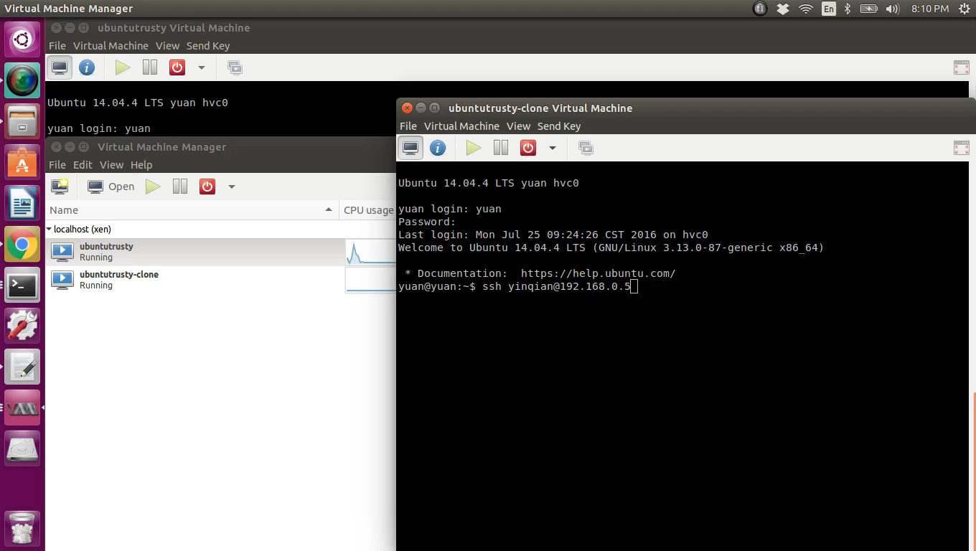
OpenSSH Authentication Bypass (3)
Y. Xiao, X. Zhang, Y. Zhang, R. Teodorescu

Slide 46
Existing Countermeasures
Y. Xiao, X. Zhang, Y. Zhang, R. Teodorescu
ECC (Error Correcting Code)
DDR4 (TRR - Target Row Refresh)
HVM (Hardware-assisted Virtualization)

Slide 47
Conclusion
Y. Xiao, X. Zhang, Y. Zhang, R. Teodorescu
We use timing channel to reverse-engineer the physical address mapping to the DRAM.
We conduct efficient double-sided row hammer attacks.
Xen PV can be exploited by row hammer and allow cross-VM access.

Slide 48
Y. Xiao, X. Zhang, Y. Zhang, R. Teodorescu

Slide 49
Row Hammer in Safe Mode
Y. Xiao, X. Zhang, Y. Zhang, R. Teodorescu
Bank b
Bit Flip
Row n-2
Row n-1
Hammering Rows
Bit Flip
Row n
Row n+1
Bit Flip
Row n+2
Safe: Row n-2, n, n+2 are mapped in the memory buffer of program

Slide 50
Bit Detection Efficiency
Y. Xiao, X. Zhang, Y. Zhang, R. Teodorescu

Slide 51
Flippable Bit Distribution
Y. Xiao, X. Zhang, Y. Zhang, R. Teodorescu

Slide 52
Effectiveness of Different Row Hammer
Y. Xiao, X. Zhang, Y. Zhang, R. Teodorescu

Slide 53
Vulnerability of Test Machines
Y. Xiao, X. Zhang, Y. Zhang, R. Teodorescu
Machine configuration | Execution time (hrs) | Vulnerable bits
(Machine A) Sandy Bridge i3-2120 (4GB) | 18.37 | 63
(Machine B) Sandy Bridge i3-2120 (4GB) | 15.85 | 91
(Machine C) Sandy Bridge i5-2500 (4GB) | 9.08 | 5622445
(Machine D) Broadwell i5-5300U (8GB) | 42.88 | 25

Slide 54
Usablility
Y. Xiao, X. Zhang, Y. Zhang, R. Teodorescu

Slide 55
Repeatability
Y. Xiao, X. Zhang, Y. Zhang, R. Teodorescu

Slide 56
Flips within 64-bit Block
Y. Xiao, X. Zhang, Y. Zhang, R. Teodorescu

